Slide 1
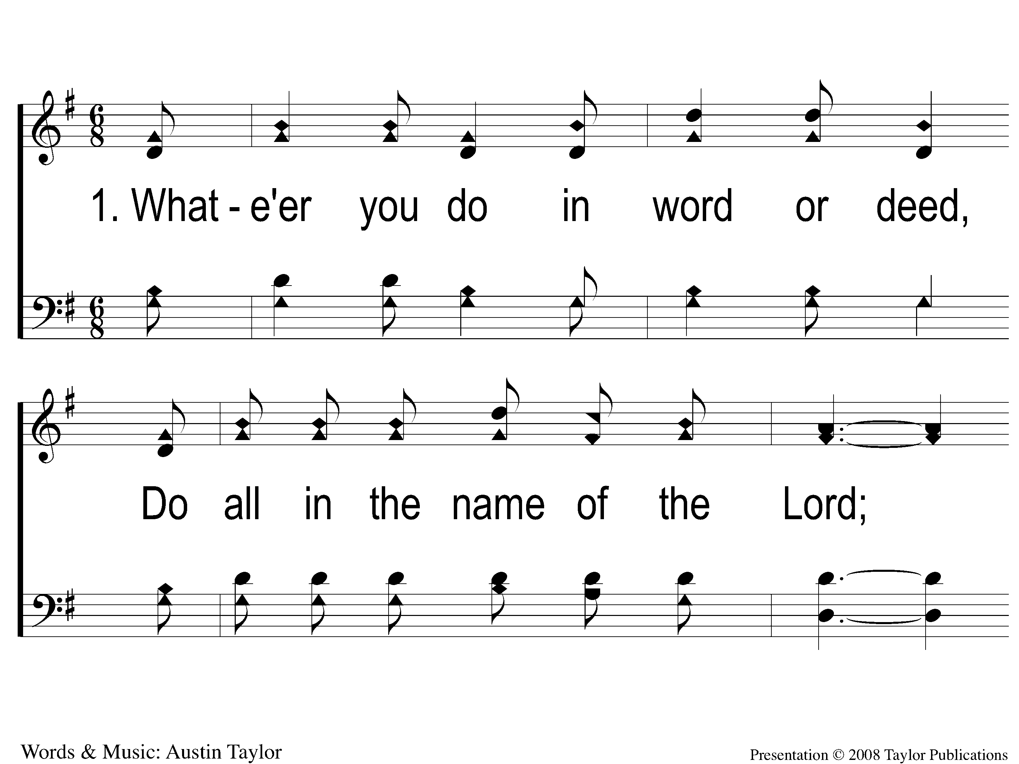
1-1 Do All In The Name Of The Lord
Do All In The Name Of The Lord
76

Slide 2
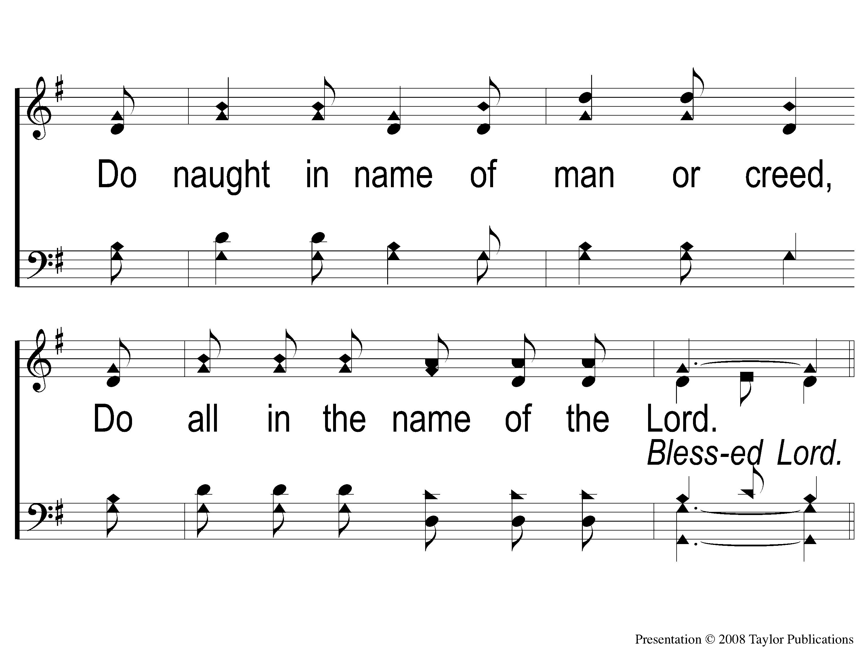
1-2 Do All In The Name Of The Lord
Do All In The Name Of The Lord
76

Slide 3
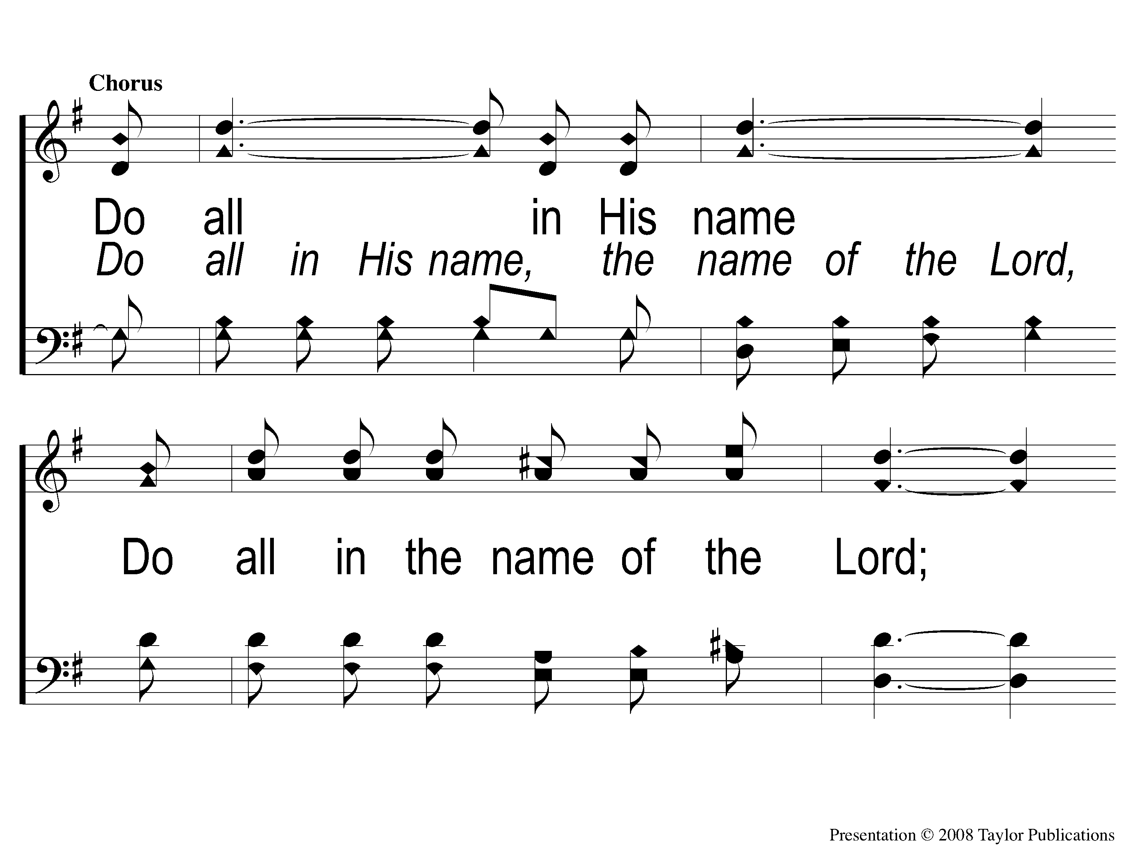
C-1 Do All In The Name Of The Lord
Do All In The Name Of The Lord
76

Slide 4
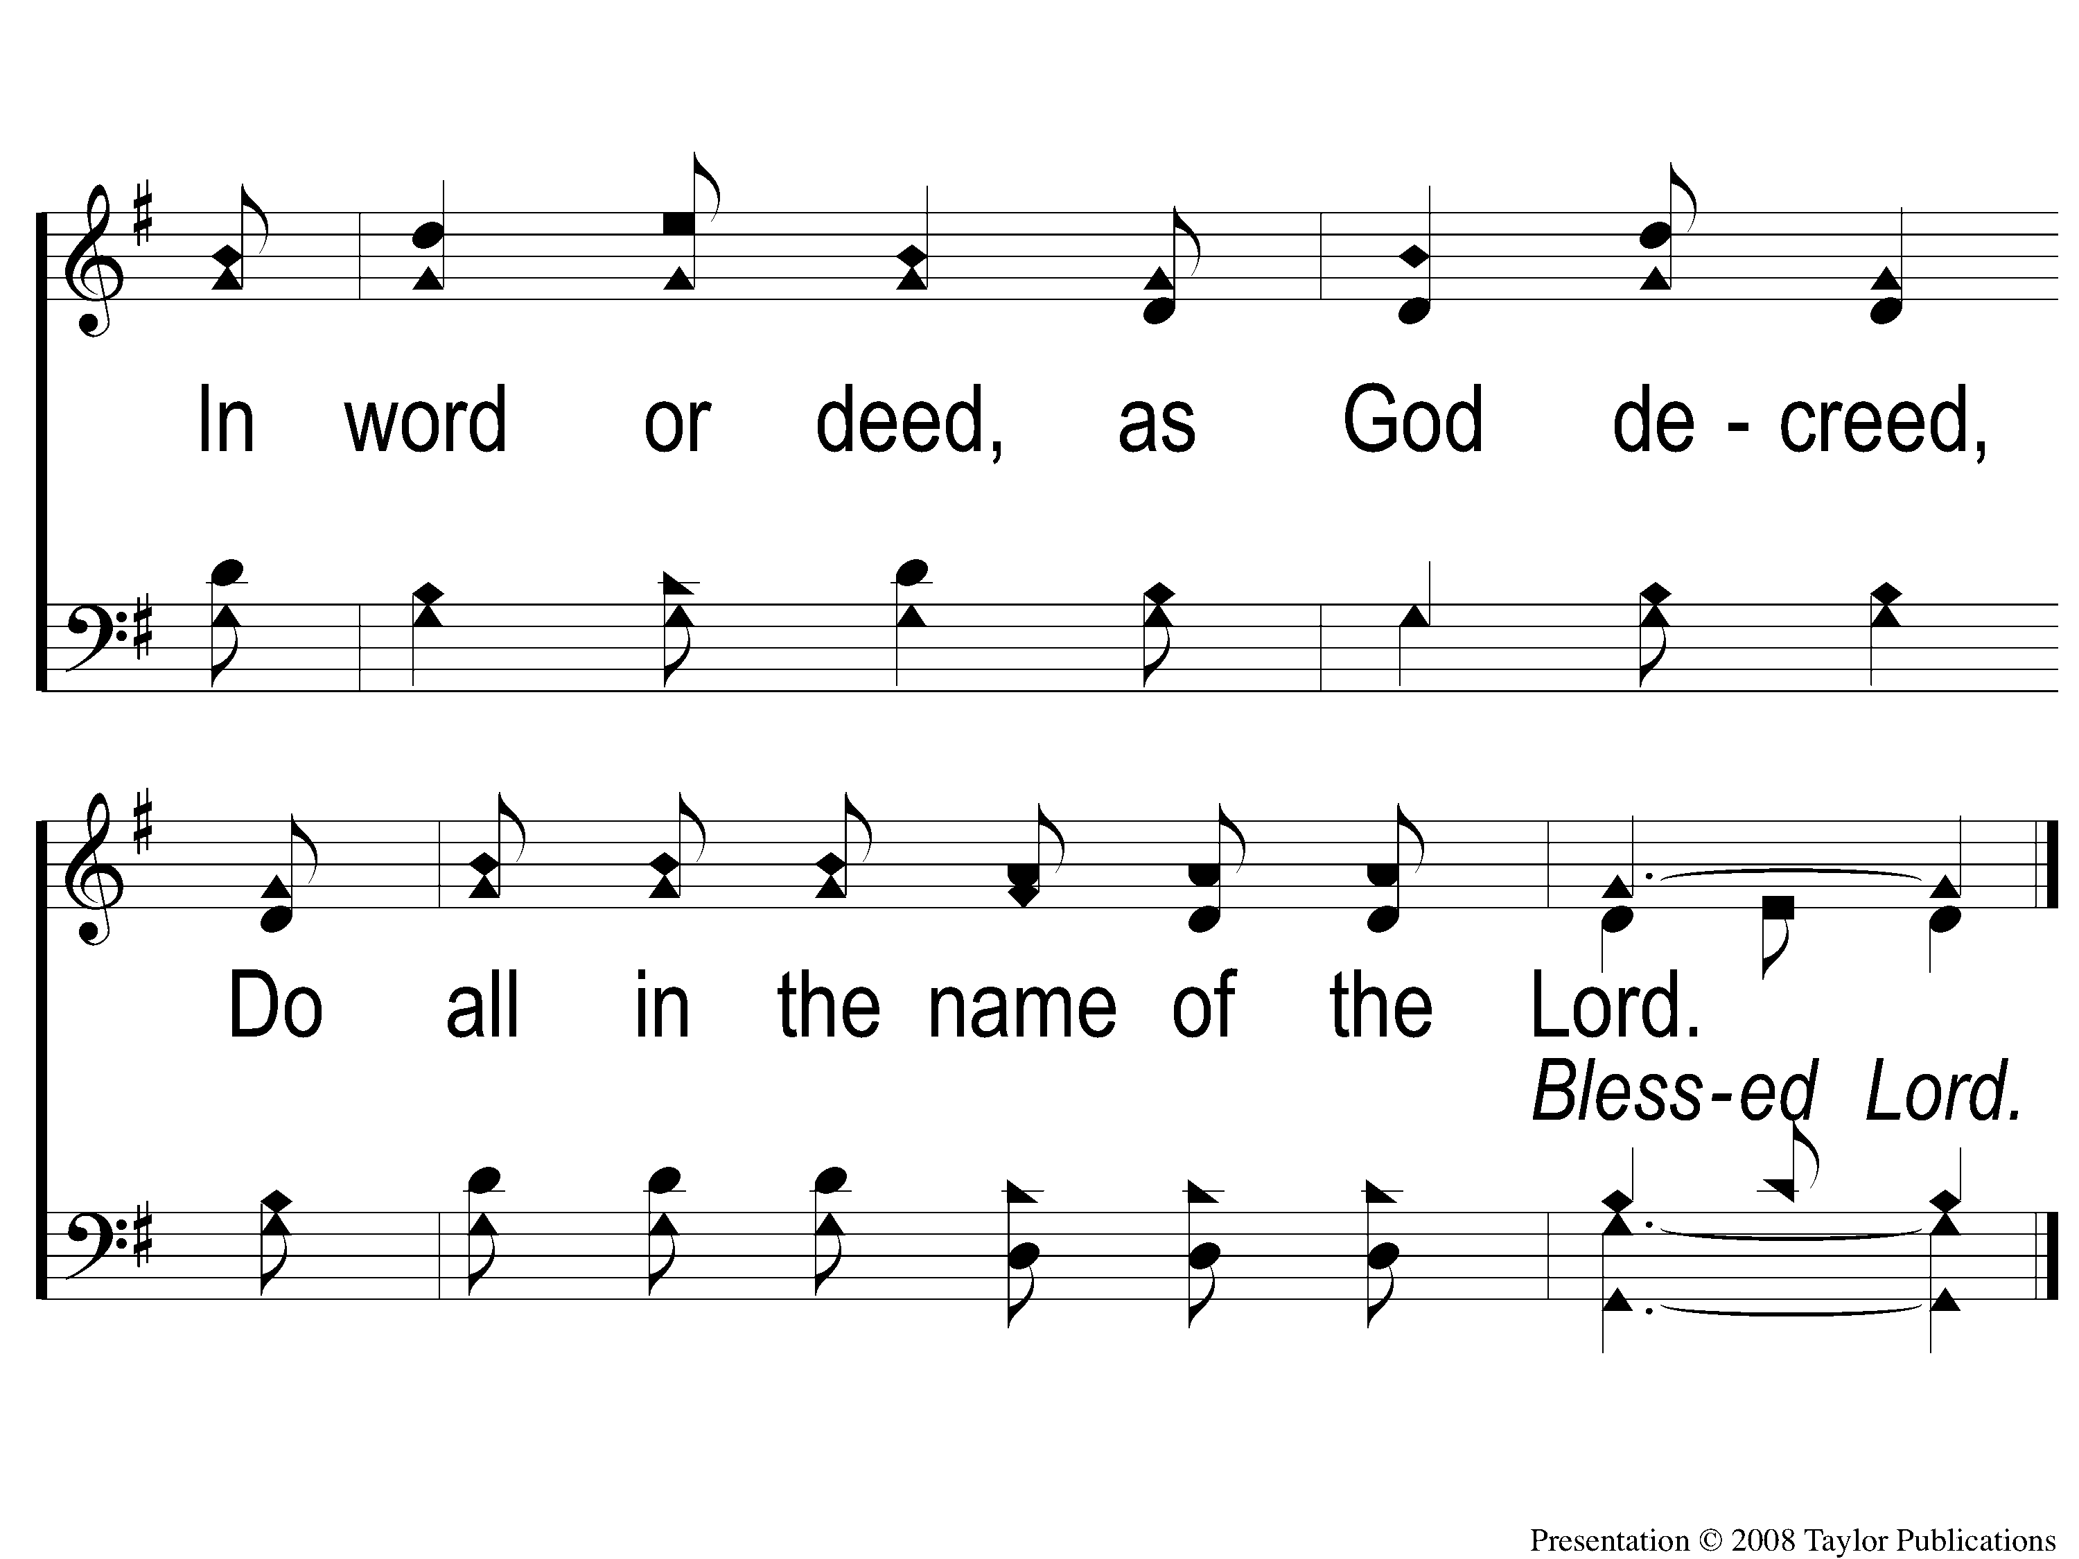
C-2 Do All In The Name Of The Lord
Do All In The Name Of The Lord
76

Slide 5
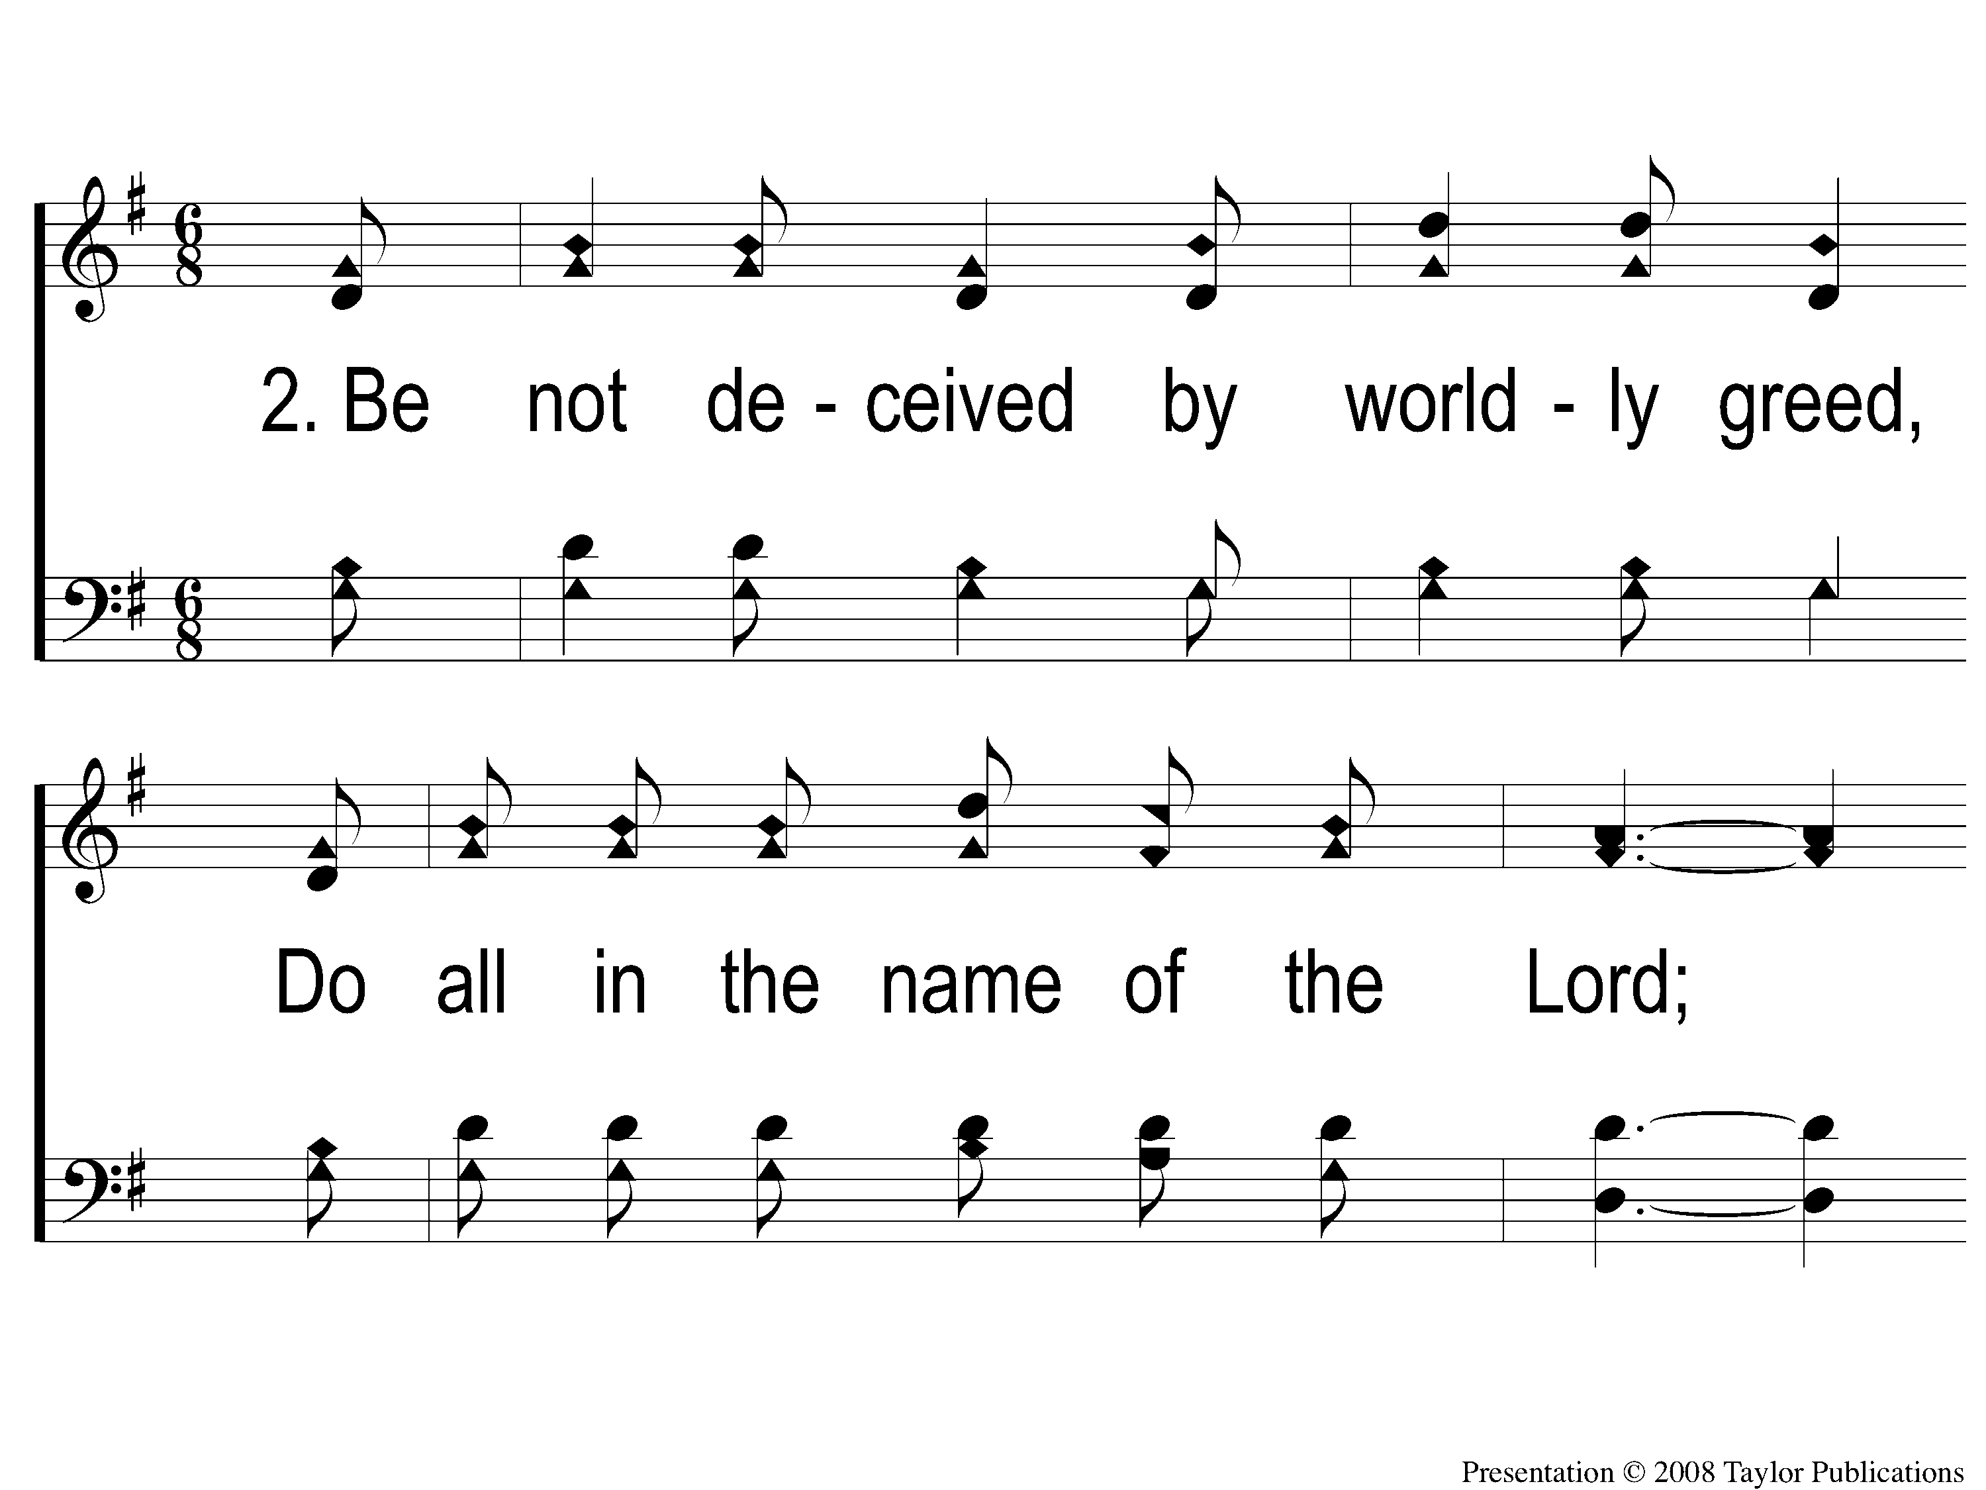
2-1 Do All In The Name Of The Lord
Do All In The Name Of The Lord
76

Slide 6
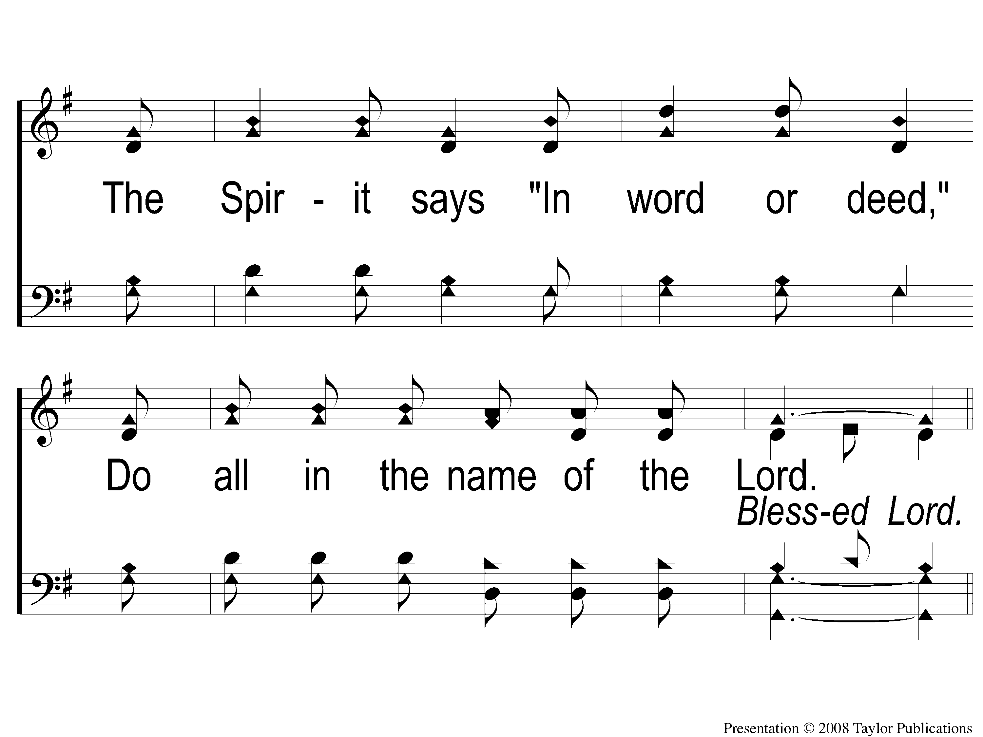
2-2 Do All In The Name Of The Lord
Do All In The Name Of The Lord
76

Slide 7
C-1 Do All In The Name Of The Lord
Do All In The Name Of The Lord
76

Slide 8
C-2 Do All In The Name Of The Lord
Do All In The Name Of The Lord
76

Slide 9
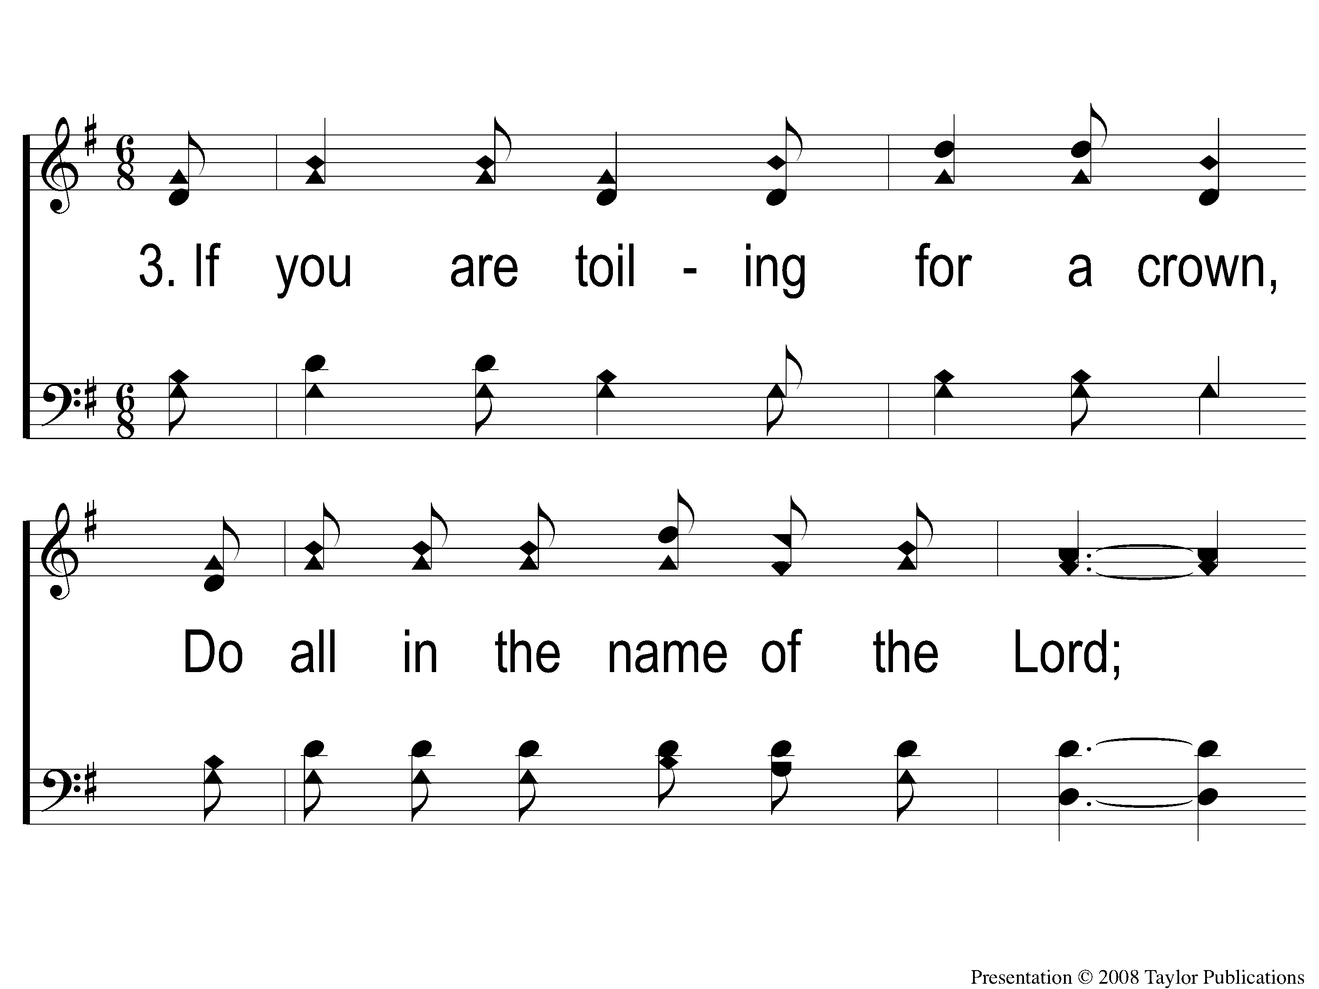
3-1 Do All In The Name Of The Lord
Do All In The Name Of The Lord
76

Slide 10
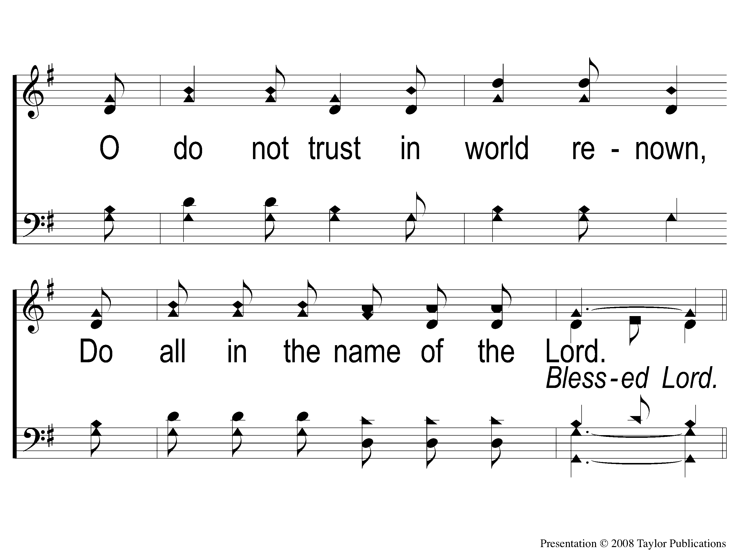
3-2 Do All In The Name Of The Lord
Do All In The Name Of The Lord
76

Slide 11
C-1 Do All In The Name Of The Lord
Do All In The Name Of The Lord
76

Slide 12
C-2 Do All In The Name Of The Lord
Do All In The Name Of The Lord
76

Slide 13
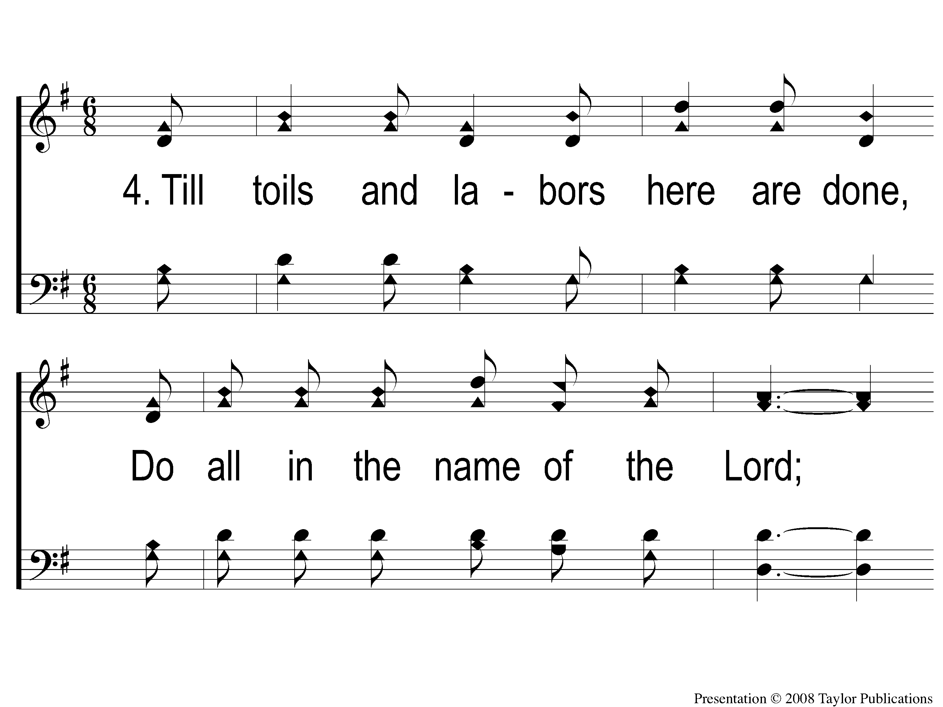
4-1 Do All In The Name Of The Lord
Do All In The Name Of The Lord
76

Slide 14
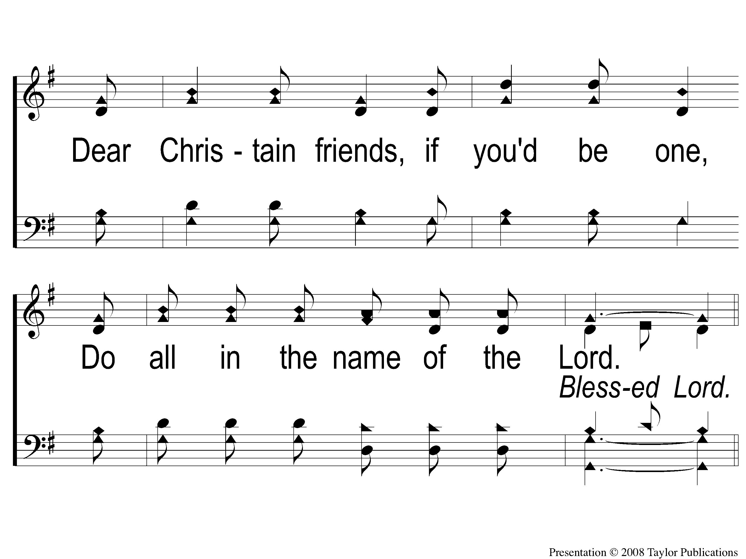
4-2 Do All In The Name Of The Lord
Do All In The Name Of The Lord
76

Slide 15
C-1 Do All In The Name Of The Lord
Do All In The Name Of The Lord
76

Slide 16
C-2 Do All In The Name Of The Lord
Do All In The Name Of The Lord
76

